Slide 1
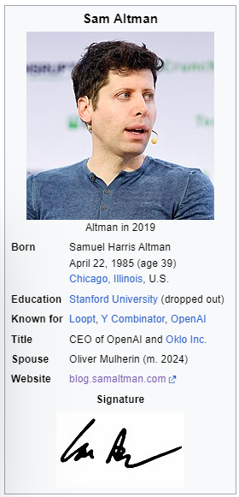
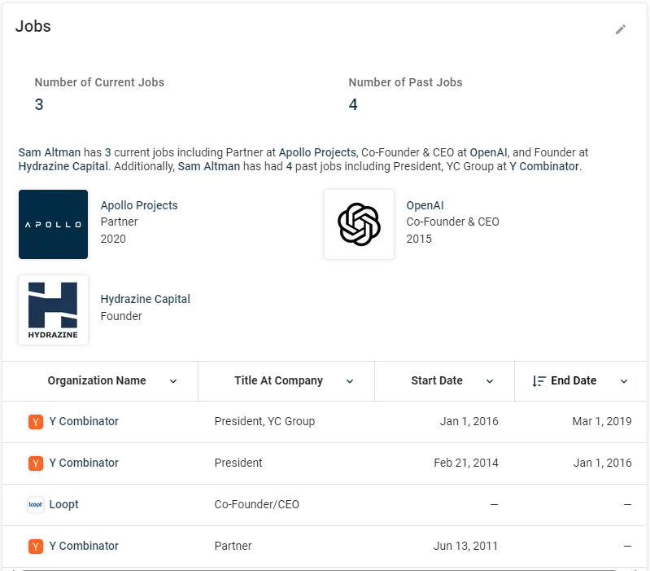
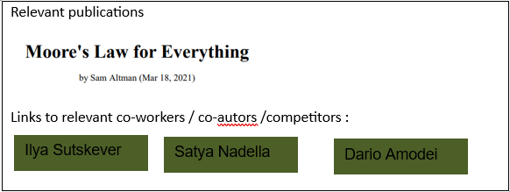
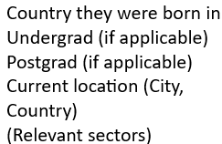
People of AI
ceps.ai/people#samaltman
<Short bio of where they are from, where they have worked and what they do now>
<Some text about the current organisations they work for>
<Link to personal website>

Slide 2
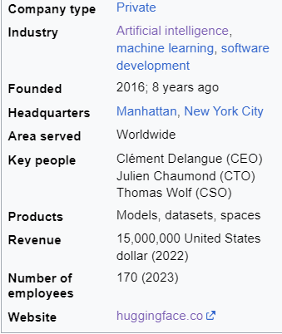

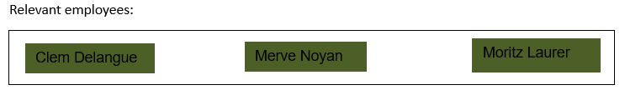

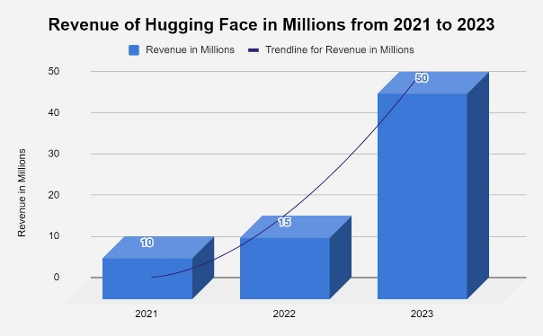
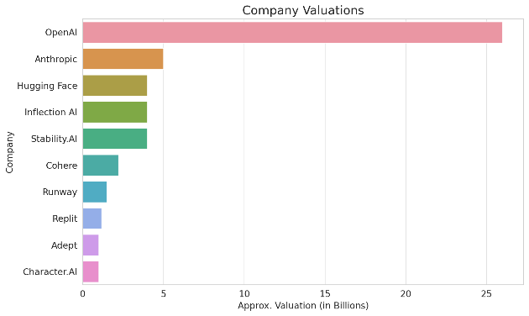
Orgs of AI
ceps.ai/orgs#huggingface
Offices
<Short bio of where they are from, where they have worked and what they do now>
NYC
Paris
Partners
Growth / Competition
Remote first
Notes:
<Text about viz of trajectory of company over time: Instead of revenue it could be investment / share value / etc. and some chart comparing the company to others:>

